Slide 1
DS 640 - Predictive Analysis & Finance Model
Predict Monkeypox
Submitted by:
Shri Lakshmi Rajagopal
Sai Sindhuja Volaboju

Slide 2
Problem Statement
Human monkeypox was first identified in humans in 1970 in the Democratic Republic of the Congo in a 9-month-old boy in a region where smallpox had been eliminated in 1968. Since then, most cases have been reported from rural, rainforest regions of the Congo Basin, particularly in the Democratic Republic of the Congo and human cases have increasingly been reported from across central and west Africa. Since 1970, human cases of monkeypox have been reported in 11 African countries: Benin, Cameroon, the Central African Republic, the Democratic Republic of the Congo, Gabon, Cote d’Ivoire, Liberia, Nigeria, the Republic of the Congo, Sierra Leone and South Sudan. The true burden of monkeypox is not known. For example, in 1996–97, an outbreak was reported in the Democratic Republic of the Congo with a lower case fatality ratio and a higher attack rate than usual. A concurrent outbreak of chickenpox (caused by the varicella virus, which is not an orthopoxvirus) and monkeypox was found, which could explain real or apparent changes in transmission dynamics in this case. Since 2017, Nigeria has experienced a large outbreak, with over 500 suspected cases and over 200 confirmed cases and a case fatality ratio of approximately 3%. Cases continue to be reported until today.
Monkeypox is a disease of global public health importance as it not only affects countries in west and central Africa, but the rest of the world. In 2003, the first monkeypox outbreak outside of Africa was in the United States of America and was linked to contact with infected pet prairie dogs. These pets had been housed with Gambian pouched rats and dormice that had been imported into the country from Ghana. This outbreak led to over 70 cases of monkeypox in the U.S. Monkeypox has also been reported in travelers from Nigeria to Israel in September 2018, to the United Kingdom in September 2018, December 2019, May 2021 and May 2022, to Singapore in May 2019, and to the United States of America in July and November 2021. In May 2022, multiple cases of monkeypox were identified in several non-endemic countries. Studies are currently underway to further understand the epidemiology, sources of infection, and transmission patterns.

Slide 3
Objective
The number of cases of monkeypox is rising daily, therefore let's hope that doctors can foresee its pattern, symptoms, and treatments as soon as possible before it spreads like wildfire.
Monkeypox is an infectious disease caused by the monkeypox virus that can occur in certain animals, including humans. Symptoms begin with fever, headache, muscle pains, swollen lymph nodes, and feeling tired.
As data scientists, we might strive to forecast trends in the hopes that we can use the data at hand to discover a solution.
Monkey pox is,
Rare, sometimes life-threatening zoonotic infection
Endemic in the west and central Africa
▪ Caused by Monkeypox virus (which is an orthopoxvirus)
▪ Specific animal reservoir unknown, but likely small mammals
▪ Can spread from infected animals to humans and person-to-person
Respiratory secretions
Skin-to-skin contact with infected body fluids (e.g., fluid from vesicles and pustules)
Fomites (e.g., shared towels, contaminated bedding)

Slide 4
Monkey pox
Monkey pox is a rare disease caused by infection with the monkey pox virus. Monkey pox virus is part of the same family of viruses as variola virus, the virus that causes smallpox. Monkey pox symptoms are similar to smallpox symptoms, but milder, and monkey pox is rarely fatal. Monkey pox is not related to chickenpox.
Monkey pox can spread to anyone through close, personal, often skin-to-skin contact, including: Direct contact with monkey pox rash, scabs, or body fluids from a person with monkey pox. Touching objects, fabrics (clothing, bedding, or towels), and surfaces that have been used by someone with monkey pox

Slide 5
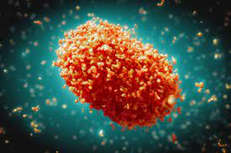
Structure

Slide 6
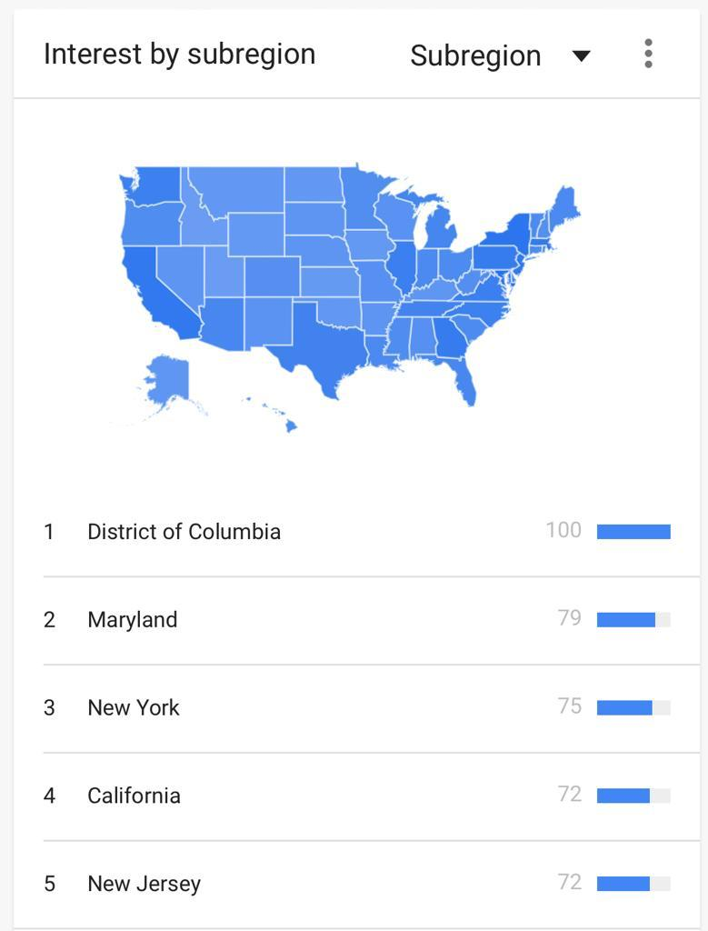
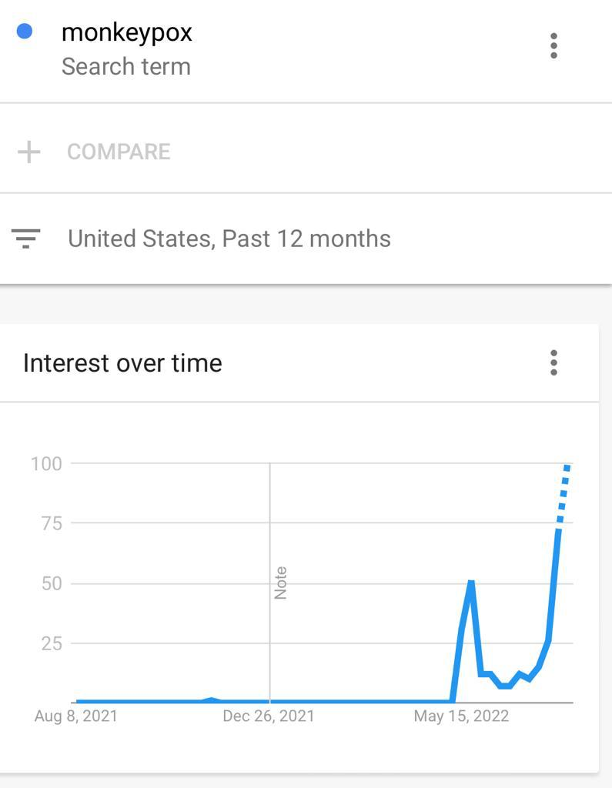
Monkey pox Cases from past 12months in USA

Slide 7
Exploratory data analysis
On May 6, 2022, a monkeypox epidemic was reported. It started with a British citizen who, on April 29, 2022, after visiting Nigeria (where the illness is widespread), displayed symptoms that were compatible with monkeypox.
On May 4, the resident returned to the UK, resulting in the outbreak's index case in that nation.
This dataset includes a count of both confirmed and suspected cases across all nations.
The EDA includes below,
Top 10 Countries based on Confirmed Cases
Top 10 Countries based on Suspected Cases
Top 10 Countries based on Hospitalized Cases
Top 10 Countries based on Cases having Travel History
Top 10 Countries based on Cases not having Travel History
Confirmed Monkey Pox Cases Across The Globe
Suspected Monkey Pox Cases Across The Globe

Slide 8
Data Modeling
Linear Regression
Decision Tree Regressor
Random Forest Regressor
Elastic Net Regressor

Slide 9
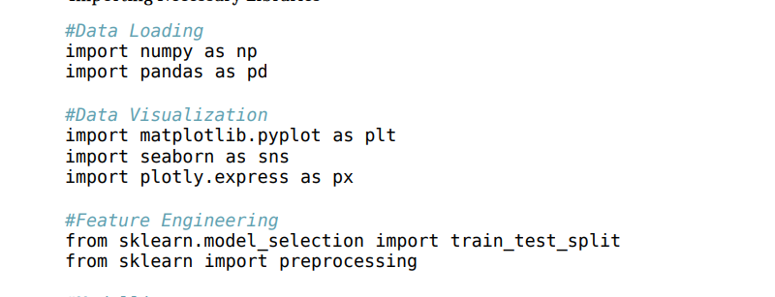
Import necessary Libraries
Linear Regression
Decision Tree Regressor
Random Forest Regressor
Elastic Net Regressor

Slide 10
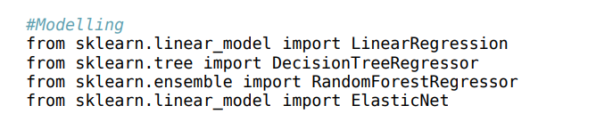
Data Modeling
Linear Regression
Deision Tree Regressor
Random Forest Regressor
Elastic Net Regressor

Slide 11
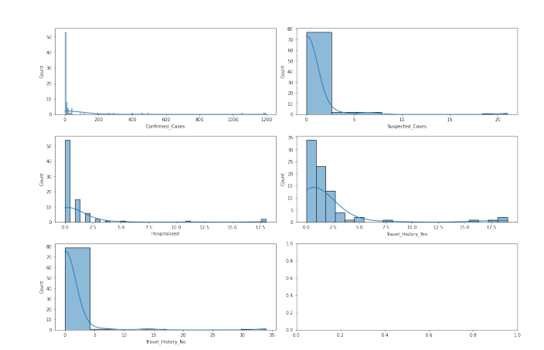
Data Visualization

Slide 12
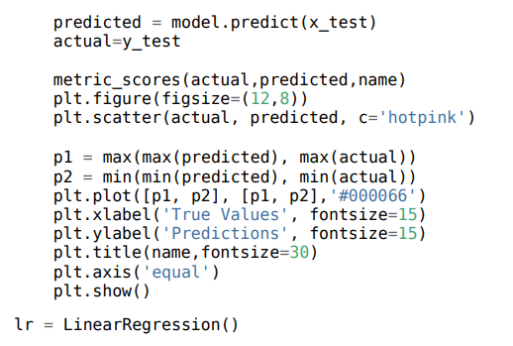
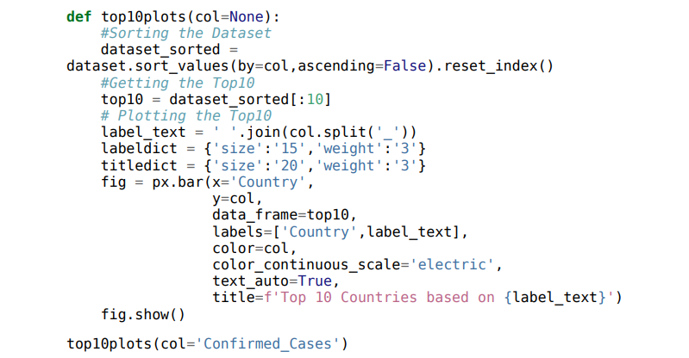
Code Snippet

Slide 13
Prevention of Monkey pox
Avoid close, skin-to-skin contact with people who have a rash that looks like monkey pox.
Do not touch the rash or scabs of a person with monkey pox.
Do not kiss, hug, cuddle or have sex with someone with monkey pox.
Avoid contact with objects and materials that a person with monkey pox has used.
Do not share eating utensils or cups with a person with monkey pox.
Do not handle or touch the bedding, towels, or clothing of a person with monkey pox.
Wash your hands often with soap and water or use an alcohol-based hand sanitizer, especially before eating or touching your face and after you use the bathroom.
In Central and West Africa, avoid contact with animals that can spread monkey pox virus, usually rodents and primates. Also, avoid sick or dead animals, as well as bedding or other materials they have touched.

Slide 14
Treatment for Monkey pox
There are no treatments specifically for monkey pox virus infections. However, monkey pox and smallpox viruses are genetically similar, which means that antiviral drugs and vaccines developed to protect against smallpox may be used to prevent and treat monkey pox virus infections.
Antiviral, such as tecovirimat (TPOXX), may be recommended for people who are more likely to get severely ill, like patients with weakened immune systems.
If you have symptoms of monkey pox, you should talk to your healthcare provider, even if you don’t think you had contact with someone who has monkey pox.

Slide 15
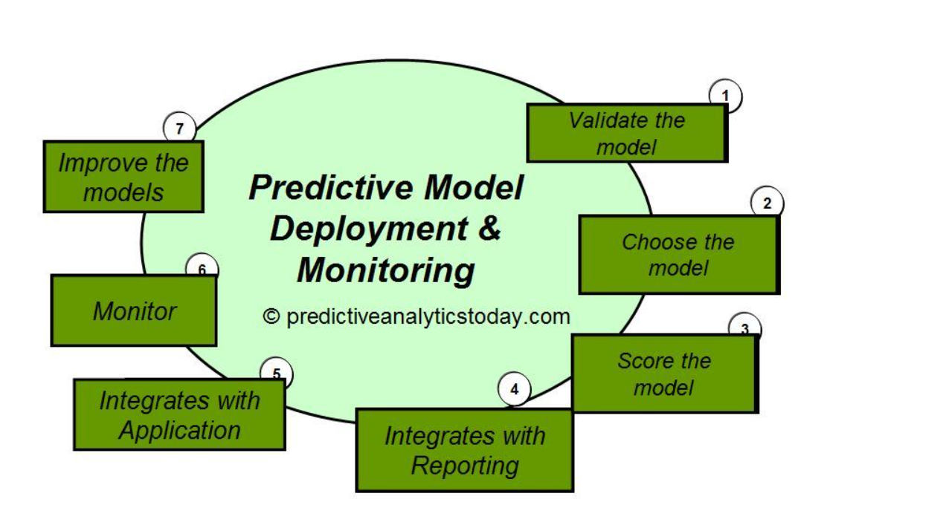
Deployment model

Slide 16
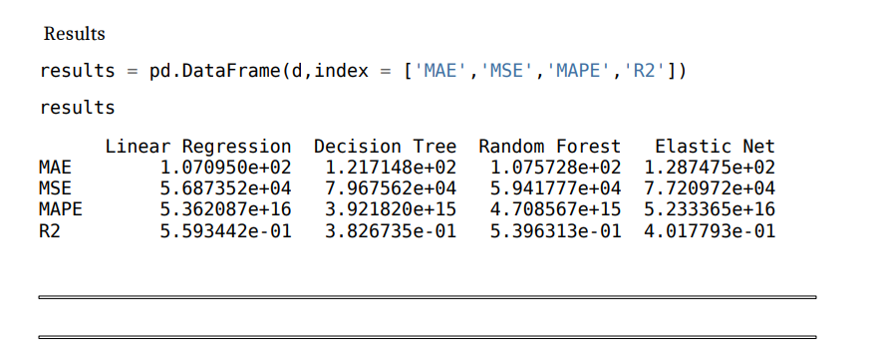
Conclusion
All our model results are now poor, but maybe as more data comes in, they will become better.
The statistic I'll be using for model evaluation is R2, and Decision Tree is currently the best model we have.

Slide 17
THANK YOU

